Slide 1
Survival Analysis II
Content prepared by Joris Menten

Slide 2
Overview
Part II:
  quantifying survival probabilities
    risk and hazard
  estimating treatment effects
    hazard ratio
    Cox regression
  multivariable Cox regression

Slide 3
Quantifying survival probabilities
Mortality risk:
  number that die/number at risk
  absolute
  during a certain period
    unconditional: at risk = all patients
    conditional: at risk = all patients that survived at least up to the start of the period

Slide 4
Quantifying survival probabilities
Calculating with risks:
  calculate mortality risk over longer period
    multiply survival probabilities
Example: mortality risk in 1 month = 10%
    of 100 patients how many are dead after 1 year ?
      After 1 month: 0.9*100=90 alive
      After 2 months: 0.9*90=0.9*0.9*100=81 are alive
      After 3 months: 0.9*81=0.9*0.9*0.9*100=73 are alive
      ...
      After 12 months: 0.9 to the power 12 * 100 = 28 are alive
      Mortality risk over 1 year = 100%-28% !! NOT: 12*10% !!

Slide 5
Quantifying survival probabilities
Calculating with risks:
  compare risks over different periods
Example: 1) mortality risk = 5% in a week
    2) mortality risk = 22% in a month
  For 1): survival probability for 1 week = 0.95
  survival probability for 1 day = 7th root of 0.95 =
  0.95 to the power 1/7 = 0.9927
  daily mortality risk is 0.73%
  For 2): survival probability for 1 month = 0.78
  survival probability for 1 day = 30th root of 0.78 =
  0.78 to the power 1/30 = 0.9918
  daily mortality risk is 0.82%
Highest risk ?

Slide 6
Quantifying survival probabilities
Hazard:
  mortality risk for an extremely short period
  instantaneous death rate
  not necessarily constant
  function of time: h(t)
  can be estimated from the death rate (=mortality risk/period duration) over a short period

Slide 7
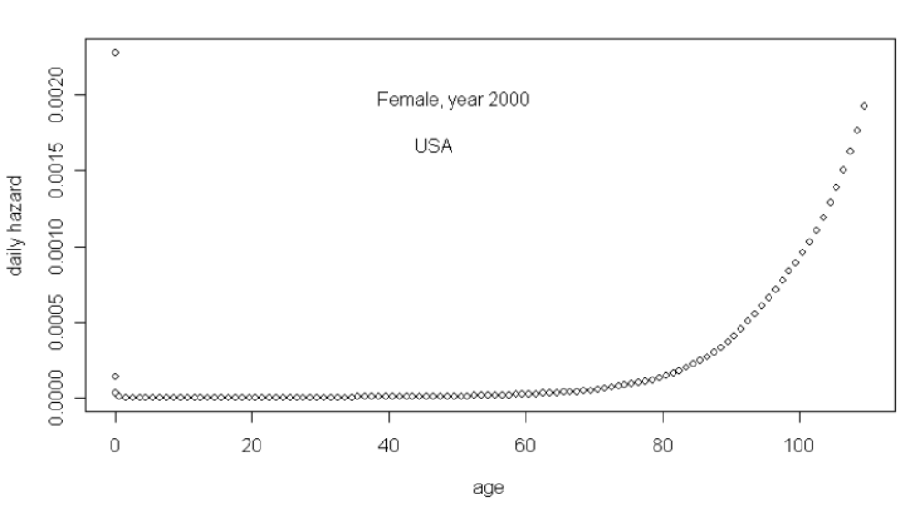
Hazard: bathtub model

Slide 8
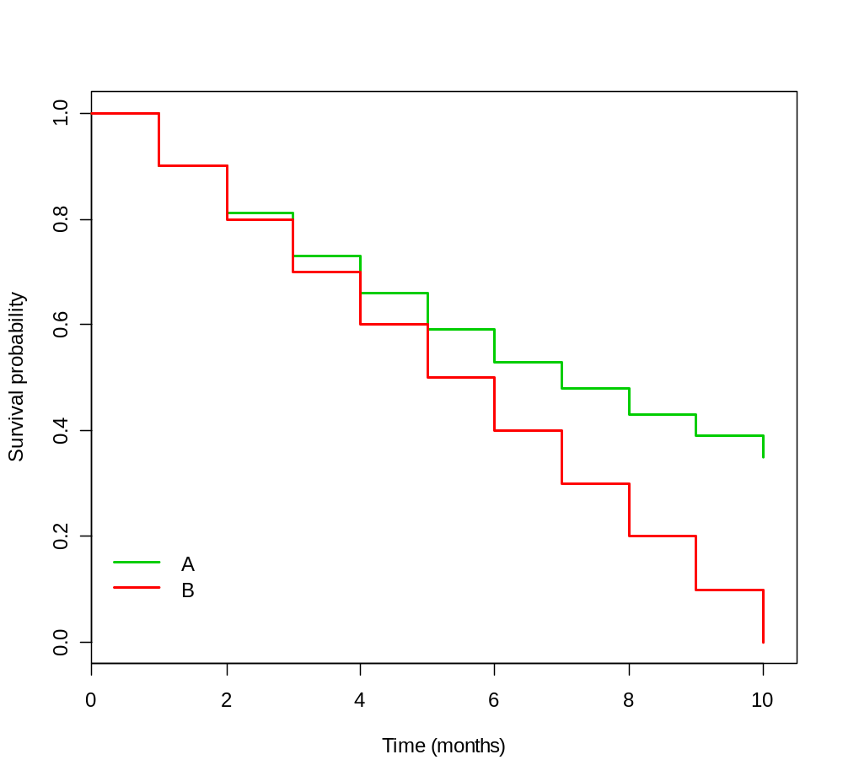
Hazard
Which KM curve shows
a constant hazard ?

Slide 9
Hazard
Estimate the hazard function over all periods of 2 months duration for both curves:
 | Group A |  |  | Group B
 | At risk | Died | Monthly mortality rate | At risk | Died | monthly mortality rate
0-2 months | 100 | 19 | 0.095 | 100 | 20 | 0.100
2-4 months | 81 | 15 | 0.093 | 80 | 20 | 0.125
4-6 months | 66 | 13 | 0.098 | 60 | 20 | 0.165
6-8 months | 53 | 10 | 0.094 | 40 | 20 | 0.250
8-10 months | 43 | 8 | 0.093 | 20 | 20 | 0.500
Group A: constant hazard Group B: increasing hazards

Slide 10
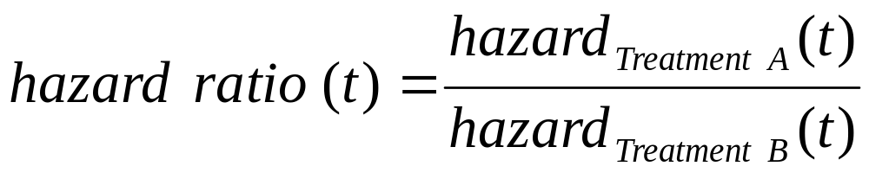
Hazard ratio
Treatment effect can be estimated by:
  function of time: treatment effect may vary over time

Slide 11
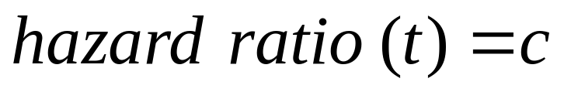
Proportional hazards
  only if the hazard ratio (HR) is constant over time, it make sense to estimate it by a single number
    so:
    or:
    hazards are proportional to each other:
  Proportional hazard assumption
    Note: hazards do not need to be constant over time

Slide 12
Interpretation of the hazard ratio
HR < 1: hazard on treatment A < hazard on treatment B
  the risk of dying is lower on treatment A compared to treatment B
  the average survival time is longer on A compared to B
  if survival: A is better than B
    (if the event is positive - time to pain relief or time to cure -,
    then B is better than A)
HR = 1: hazard on treatment A = hazard on treatment B
  no difference between A and B
HR > 1: hazard on treatment A > hazard on treatment B
  the risk of dying is higher on treatment A compared to treatment B
  the average survival time is shorter on A compared to B
  if survival: A is worse than B

Slide 13
Hazard ratio
Interpretation of HR similar to relative risk
  but HR is not equal to RR:
    Note: if HR<1 then OR < HR < RR
        if HR>1 then OR > HR > RR
  if risk is small then:
      Hazard Ratio ≅ Relative Risk ≅ Odds Ratio

Slide 14
Cox regression
Estimating HR: Cox regression
  flexible modeling strategy to estimate and test effects on survival rate
    allows to calculate adjusted effect estimates
    assess confounding and interaction
    select best predictors
  complete fields as for Kaplan-Meier curves

Slide 15
Cox regression in R commander
library(survival)
mod <- coxph(Surv(Time, Event) ~ GliomaType, data=dat)
summary(mod)

Slide 16
Output
Wald test
Ho= HR is 1
n= 51, number of events= 42
coef exp(coef) se(coef) z Pr(>|z|)
GliomaTypeG 0.9270 2.5268 0.3497 2.651 0.00803 **
---
Signif. codes: 0 ‘***’ 0.001 ‘**’ 0.01 ‘*’ 0.05 ‘.’ 0.1 ‘ ’ 1
exp(coef) exp(-coef) lower .95 upper .95
GliomaTypeG 2.527 0.3958 1.273 5.015
Concordance= 0.609 (se = 0.042 )
Likelihood ratio test= 7.68 on 1 df, p=0.006
Wald test = 7.03 on 1 df, p=0.008
Score (logrank) test = 7.5 on 1 df, p=0.006
GliomaTypeG
1.50% higher than..
2.52 times as much than..
Glyoma Type E is:
- 0.40 times as high than type G
- 60% percent lower than Type G
- Less than half of Type G
Hazard ratio of GluomaTypeG
Hazard ratio of GluomaTypeE
(Flipped)
Which has the better survival?
GliomaTypeG, has the worse survival. HR: 2.52.
The risk of dying is higher on G compared to treatment E
The average survival time is shorter on G compared to E
LHR test
Ho: model with no independent variable = model with indepeds variables
Equation? We dont have equation because we cannot calculate predicted hazards
Long rank test
Comparing the median survival time.

Slide 17
Multivariable Cox regression
Example, find independent predictors of time to death in patients with HIV started on ARV:
  start = ART start
  event = death
  possible predictors:
    sex
    age (</> 30)
    WHO-stage (1-2 vs 3-4)
    CD4-count (</> 200)

Slide 18
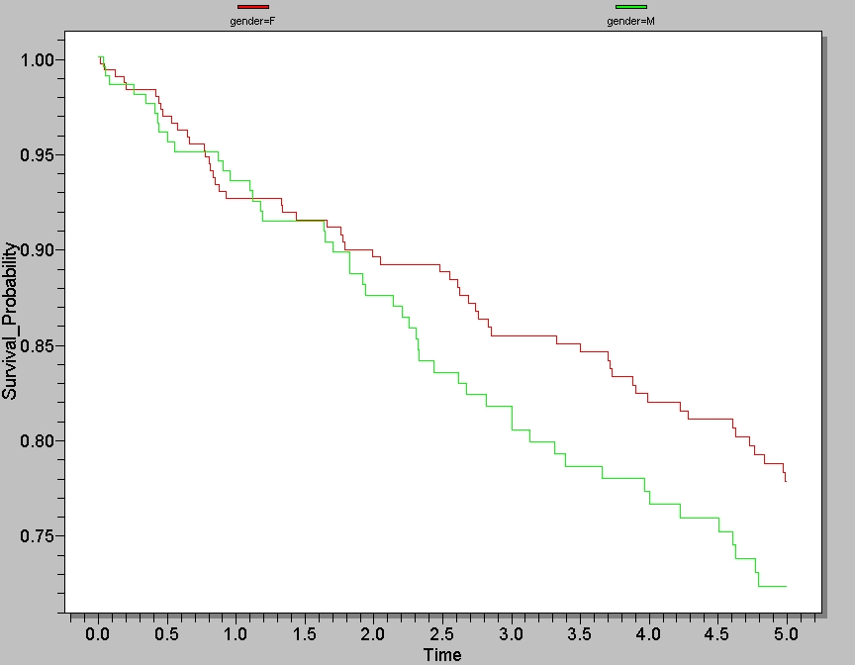

Slide 19
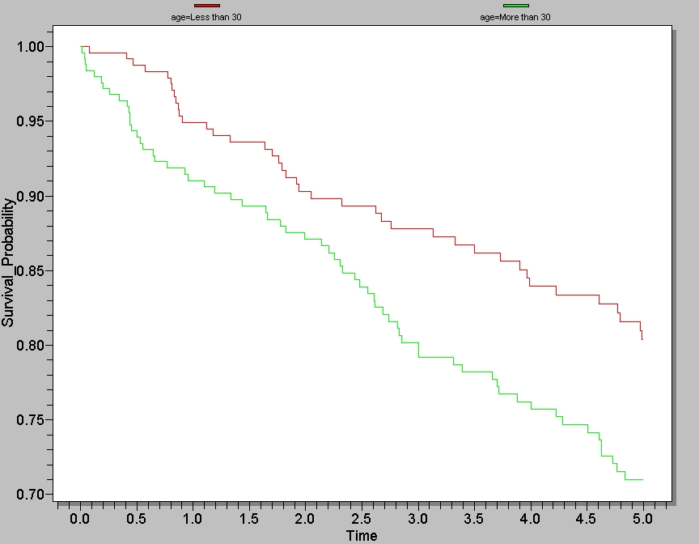

Slide 20
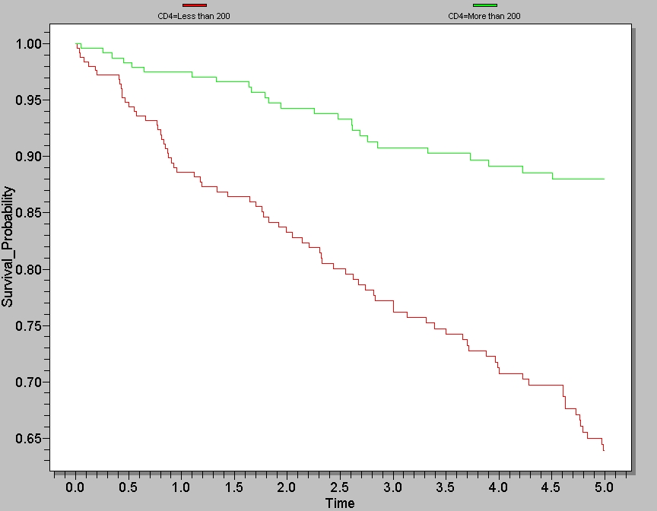

Slide 21
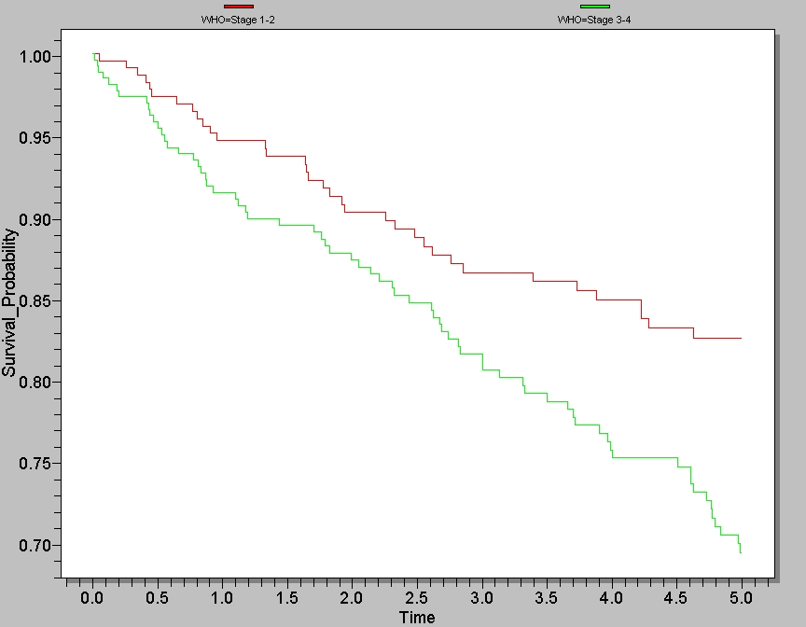

Slide 22
Building a multivariate model (general strategy) Example in Epi-Info
Step 1: Do Cox regression with each of the (possible) predictors separately:
Term Hazard Ratio 95% C.I. Coefficient S. E. Z-Statistic P-Value
age (More than 30/Less than 30) 1.6013 1.0787 2.3771 0.4708 0.2016 2.3356 0.0195
...
gender (M/F) 1.2887 0.8763 1.8951 0.2536 0.1968 1.2887 0.1975
...
cd4 (More than 200/Less than 200) 0.2944 0.1877 0.4616 -1.2229 0.2295 -5.3279 0.0
...
WHO (Stage 3-4/Stage 1-2) 1.8147 1.2082 2.7257 0.5959 0.2076 2.871 0.0041
...
Step 2: Select those with p<0.200 (or 0.100 depending on analysis plan) for further modeling:
age
gender
CD4 count
WHO stage
Step 3: Enter in multivariable models and remove step-by-step the non-significant terms (always removing the least significant factor). “Backwards elimination”.

Slide 23
Step 3.a:
Term Hazard Ratio 95% C.I. Coefficient S. E. Z-Statistic P-Value
age (More than 30/Less than 30) 1.733 1.1664 2.5751 0.5499 0.202 2.7217 0.0065
CD4 (More than 200/Less than 200) 0.2799 0.1673 0.4684 -1.2733 0.2627 -4.8467 0.0
gender (M/F) 1.3073 0.8888 1.9229 0.268 0.1969 1.3612 0.1735
WHO (Stage 3-4/Stage 1-2) 0.9897 0.6215 1.576 -0.0104 0.2374 -0.0438 0.9651
Drop WHO-stage
Note: why is WHO no longer significant ?
- WHO and CD4 strongly correlated
- “confounding” possible
 | WHO | WHO
CD4 | Stage 1-2 | Stage 3-4 | TOTAL
Less than 200 | 53 | 200 | 253
200 or more | 181 | 66 | 247
TOTAL | 234 | 266 | 500

Slide 24
Step 3.b:
Term Hazard Ratio 95% C.I. Coefficient S. E. Z-Statistic P-Value
age (More than 30/Less than 30) 1.7335 1.1668 2.5753 0.5501 0.202 2.7238 0.0065
CD4 (More than 200/Less than 200) 0.2815 0.1793 0.4418 -1.2677 0.23 -5.5117 0.0
gender (M/F) 1.3072 0.8887 1.9226 0.2679 0.1969 1.3607 0.1736
Drop gender
Step 3.c:
Term Hazard Ratio 95% C.I. Coefficient S. E. Z-Statistic P-Value
age (More than 30/Less than 30) 1.7376 1.1697 2.5813 0.5525 0.2019 2.7363 0.0062
CD4 (More than 200/Less than 200) 0.2832 0.1805 0.4444 -1.2616 0.2299 -5.487 0.0
Both predictors (independently) significant: stop model simplification.
Step 4: Test for interactions.

Slide 25
Step 4:
Term Hazard Ratio 95% C.I. Coefficient S. E. Z-Statistic P-Value
age (More than 30/Less than 30) 1.7987 1.145 2.8256 0.587 0.2304 2.5474 0.0109
CD4 (More than 200/Less than 200)0.3118 0.1484 0.6549 -1.1655 0.3787 -3.0776 0.0021
interaction 0.861 0.3386 2.1892 -0.1497 0.4762 -0.3144 0.7532
Look only at interaction p-value: not significant so the final model is the model without interaction:
Term Hazard Ratio 95% C.I. Coefficient S. E. Z-Statistic P-Value
age (More than 30/Less than 30) 1.7376 1.1697 2.5813 0.5525 0.2019 2.7363 0.0062
CD4 (More than 200/Less than 200) 0.2832 0.1805 0.4444 -1.2616 0.2299 -5.487 0.0
Note: if interaction is significant
- analyse by group (e.g. age group)
OR
- make new variable with all 4 categories, eg:
Young with low CD4
Young with high CD4
Older with low CD4
Older with high CD4

Slide 26
Model building
To identify predictors/risk factors:
  use approach described above
To adjust for confounding:
  include all possible confounders
  (model simplification is not necessary)
  confounders identified:
    from literature, subject matter knowledge (preferred approach)
    from analysis: confounders are associated with outcome and predictor of interest

